Slide 1
Session #H: Naming Things
Peter Ritchie

Slide 2
Three hard problems in software engineering
Naming
Off by one errors
Notes:
Originally cache invalidation and naming things by Phil Karlton. But I couldn’t resist two jokes in one.

Slide 3
About Me
30+ years’ experience helping enterprises optimize delivery of software systems.
Influencer, author, and blogger
Microsoft Most Valuable Professional 2007-2019
Microsoft Certified Professional, Certified SOA Analyst, Certified SAFe Architect, Azure Fundamentals, Azure Administrator.
Notes:
And Passionate about patterns and practices and sharing knowledge with software development communities.

Slide 4
Agenda
Why
Classic guidelines
The things we name
What makes it hard
Tips and techniques

Slide 5
Caveat
Notes:
The tips I’ll present are simply tools

Slide 6
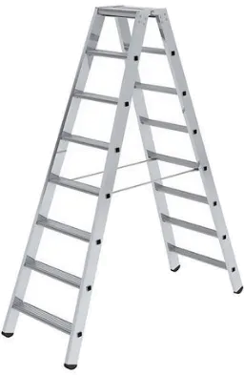

Slide 7
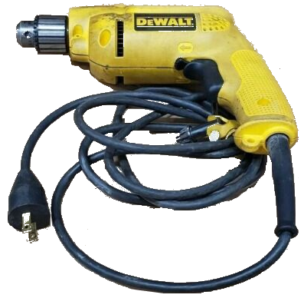

Slide 8
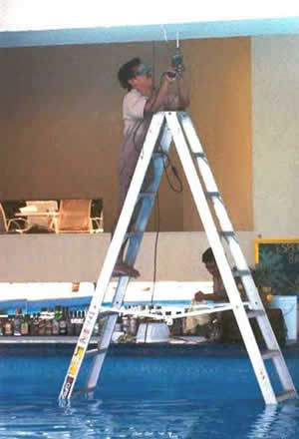

Slide 9
Why?

Slide 10
Have you ever?
public class DataManager
public bool Complete { get; set; }
namespace Console

Slide 11
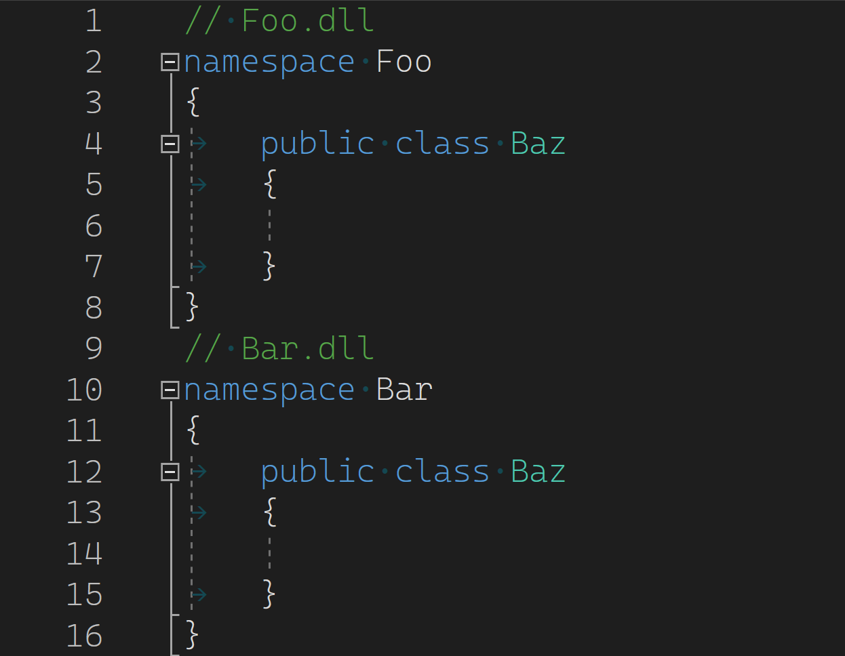
What’s the big deal?

Slide 12
What’s the big deal?

Slide 13
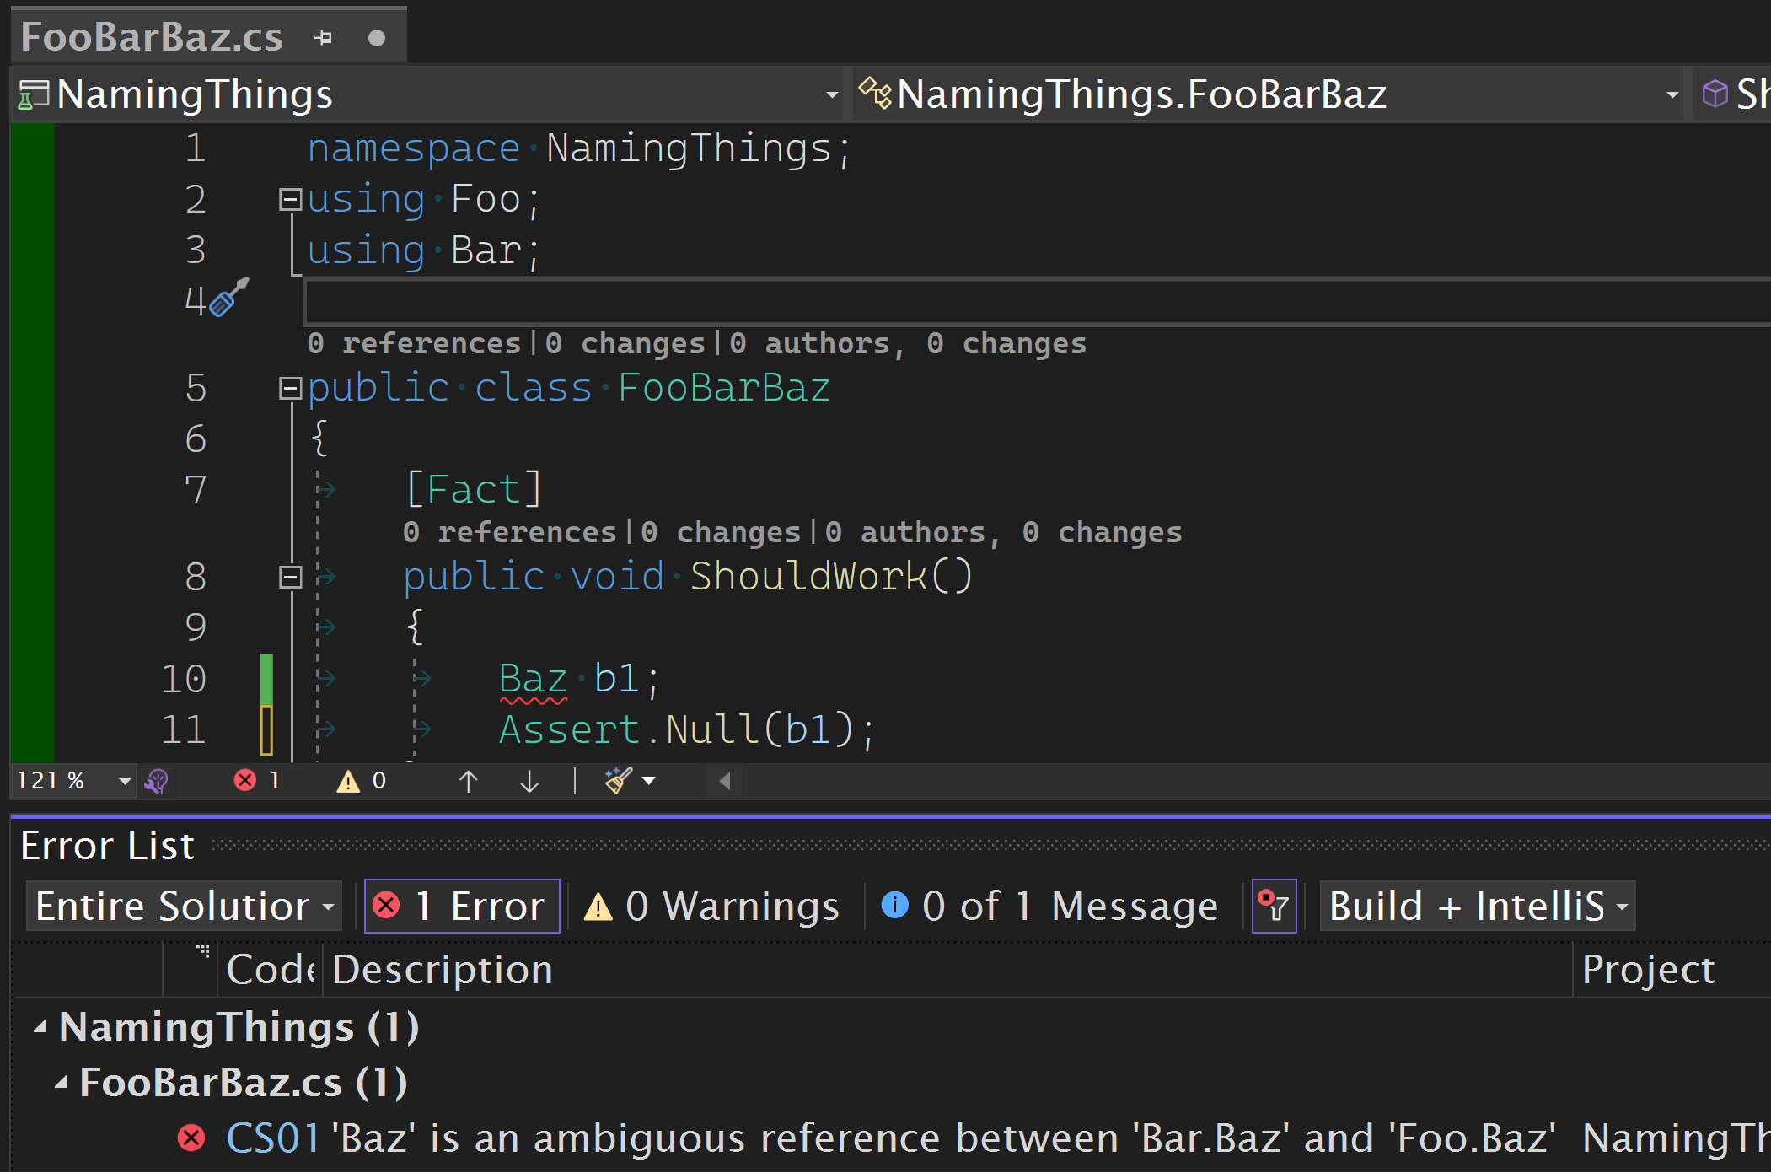
Deep changes necessary
Notes:
Corner case

Slide 14
Deep changes necessary

Slide 15
Prior Art

Slide 16
Existing Guidelines
DO name classes and structs with nouns or noun phrases
...methods, which are named with verb phrases.
DO name interfaces with adjective phrases, or occasionally with nouns or noun phrases.
.NET: Framework Guidelines

Slide 17
Existing Guidelines
Methods should be verbs.
Class names should be nouns.
Java Naming Conventions
Notes:
Pre-Oracle

Slide 18
Oh, Okay; Now it’s Clear
Verbs:
Be
Seem
Were
Nouns:
Green
Warmth
Collections

Slide 19
What do we name?
Notes:
Part of understanding where difficulties lie is understanding what we name (before we name things)

Slide 20
Other Things We Name (Scoped to This Session)
Abstract classes
Namespaces
Class libraries
Application
Service
Capabilities
Properties
Hierarchies
Sub-namespaces
Inline classes
Notes:
All these things interact and collaborate, introducing naming opportunities.

Slide 21
What contributes to difficulty?

Slide 22
English

Slide 23
English is Tricky
The bandage was wound around the wound.
The farm was used to produce produce.
The dump was so full that it had to refuse more refuse.
We must polish the polish furniture.
He could lead if he would get the lead out.
Notes:
Homographs, Initial-stress derivation nouns

Slide 24
English Constraints
Understandability
Implicit Meanings
Word classes
Parts of speech
Derivational conventions

Slide 25
Nouns
Common
Singular
Compound
Concrete
Countable
Proper
Abstract
Uncountable
Plural
Collective
Notes:
Types of nouns

Slide 26
Adjectives
Descriptive
Quantitative
Demonstrative
Interrogative
Possessive
Distributive
Article
Notes:
Types of adjectives
So,

Slide 27
“Requirements”

Slide 28
Lack of Business Clarity
Lack of intent or purpose
Lack of domain boundaries
Conflating outcome and output
Lack of clarity of input
Business process vs rule
Business Step vs Activity

Slide 29
Tips
Notes:
Some things I’ve noted or collected while coming up with this talk. These are tips, I won’t be offended if you disagree

Slide 30
Tips - General
Consistency
You can avoid clashes if things are named consistently
Don’t be Arbitrary
Group things together with purpose so that a name is apparent
Be purposeful, design with intention
Don’t try to pre-define all possible scenarios
Understanding known terminologies is essential, but don’t guess at the unknown
Be as explicit as possible, avoid ambiguity
Rely on the Business and requirements for meaning
If the requirements aren’t clear, your naming will be unclear too

Slide 31
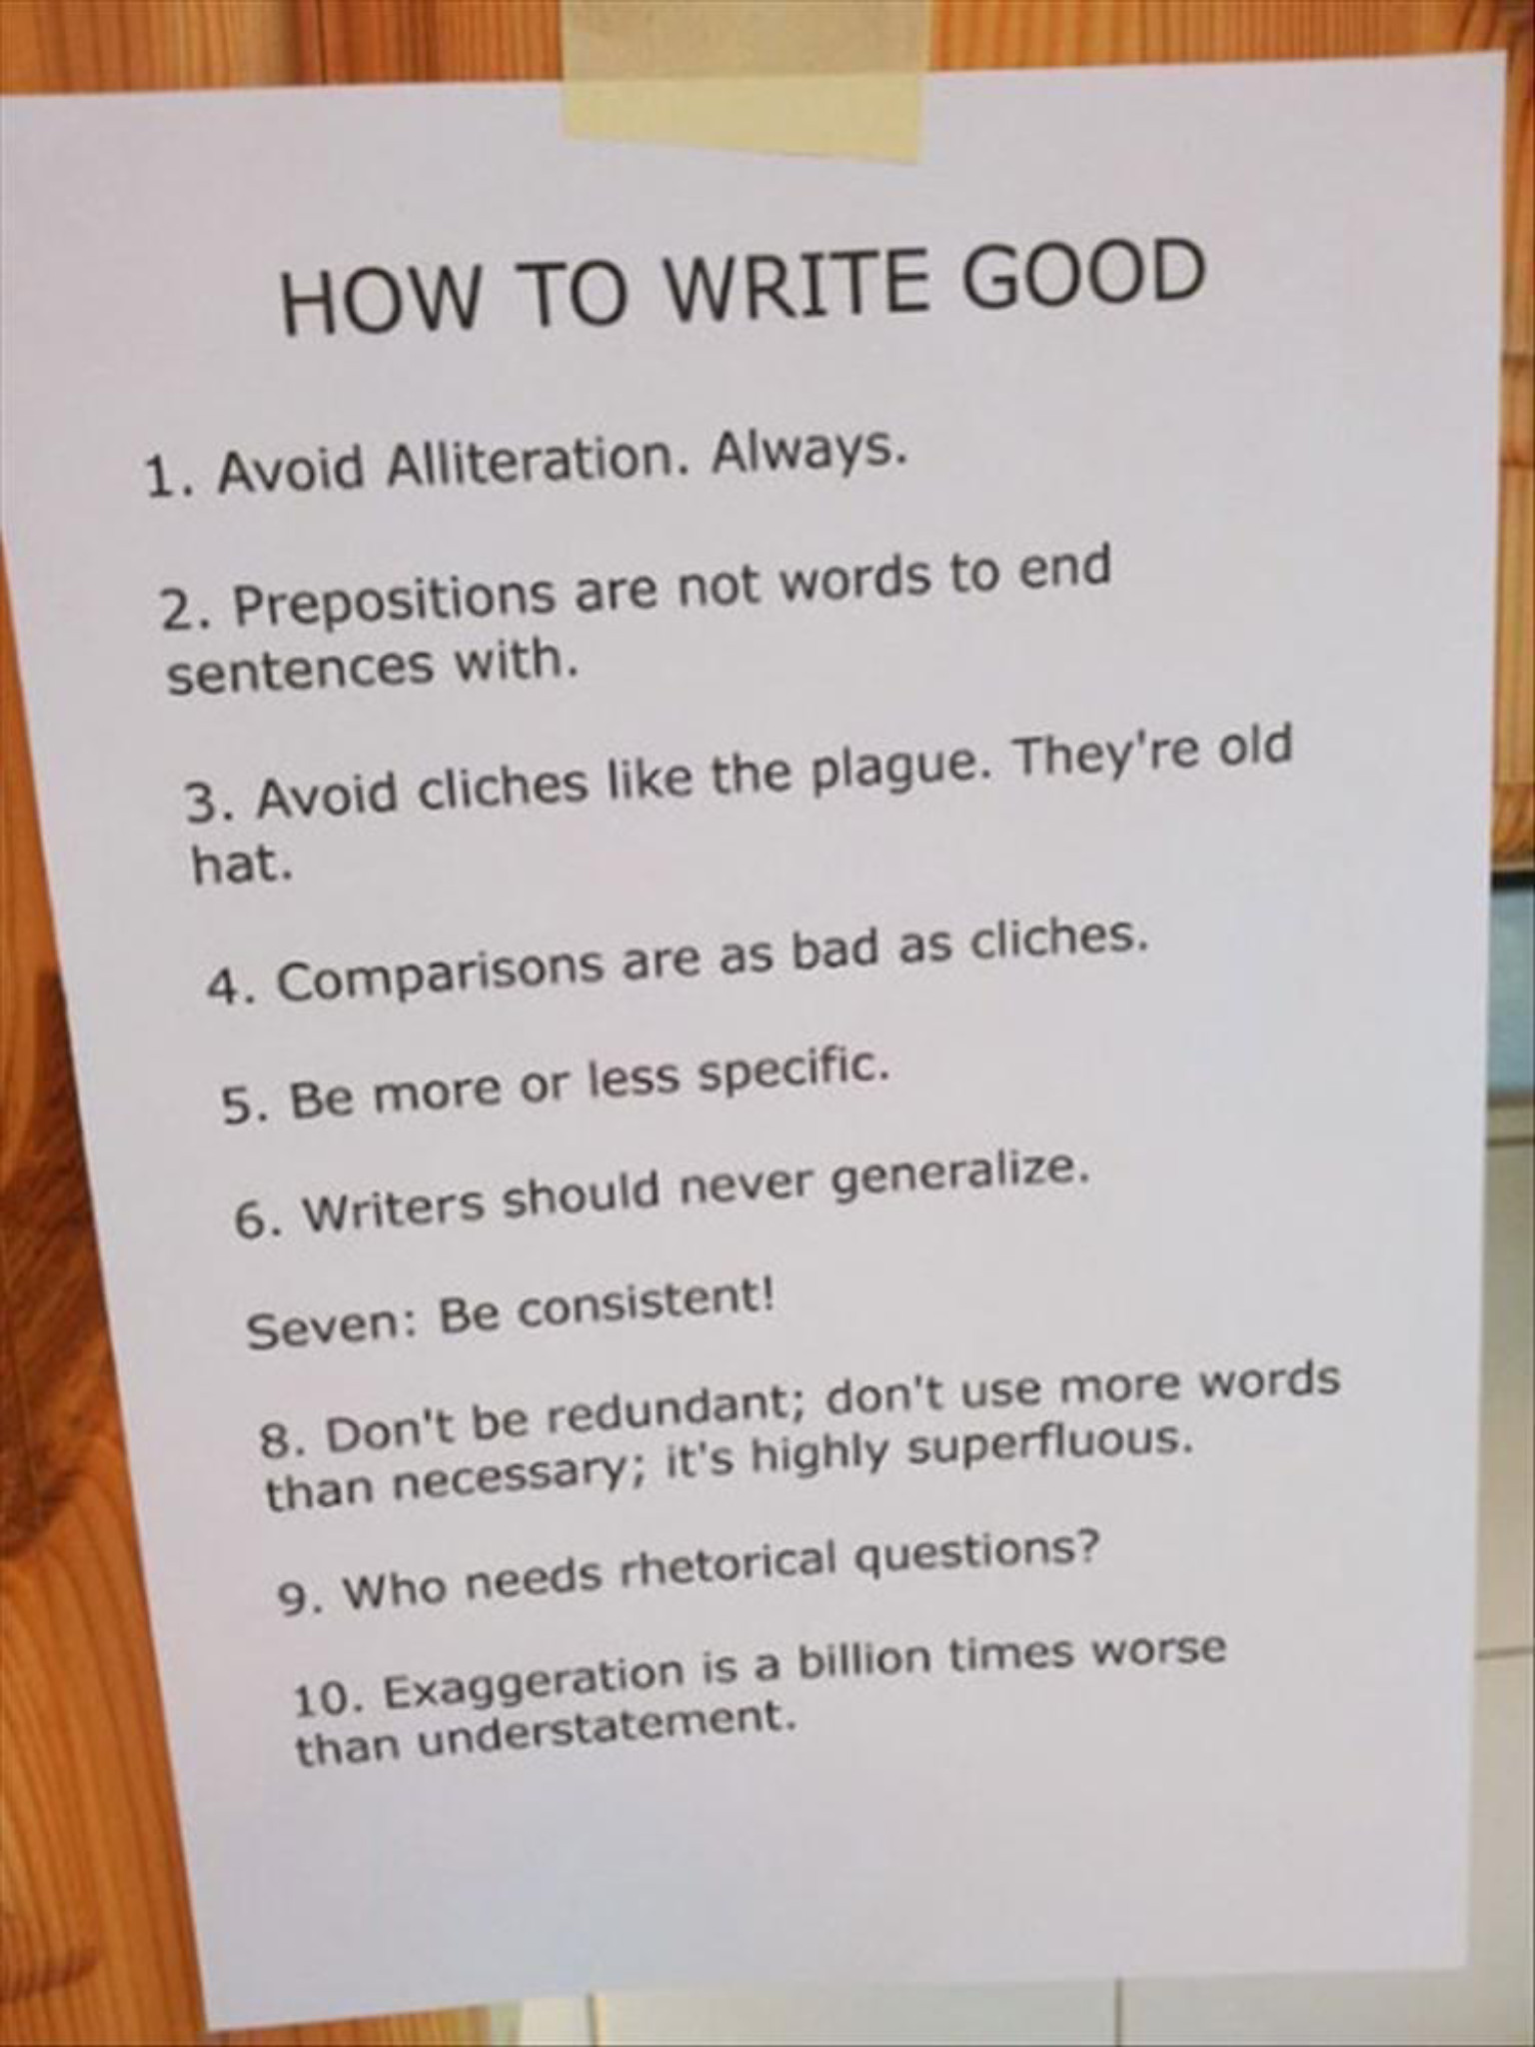

Slide 33
Tips – Use Adjectives for Namespaces
namespace MyCo.MyProduct.Mathematics
{
public static class Mathematics
{
public static T Add<T>(T left, T right)
{
//...
throw new NotImplementedException();
}
}
// ...
}
Notes:
Since I started with a negative example with a namespace…
An example that isn’t an adjective.

Slide 34
Tips – Use Adjectives for Namespaces
namespace MyCo.MyProduct.Mathematics
{
public static class Mathematics
{
public static T Add<T>(T left, T right)
{
//...
throw new NotImplementedException();
}
}
// ...
}

Slide 35
Tips – Use Adjectives for Namespaces
namespace MyCo.MyProduct.Mathematical
{
public static class Mathematics
{
public static T Add<T>(T left, T right)
{
//...
throw new NotImplementedException();
}
}
// ...
}

Slide 36
Tips – Use Adjectives for Namespaces
namespace MyCo.MyProduct.Mathematical
{
public static class Mathematics
{
public static T Add<T>(T left, T right)
{
//...
throw new NotImplementedException();
}
}
// ...
}
Notes:
…and yes, this is a bad example. Maybe I’ll create a session on writing example code that isn’t bad. :D

Slide 37
Tip – Use Plurals for Namespaces
namespace System.Collections
{
public class ArrayList;
public class Queue;
public class SortedList;
public class Stack;
}
Notes:
An adjective doesn’t necessarily make sense in every scenario. You may group together types that share a hierarchy or a base class. In cases like this you’re describing a collection of types so a plural makes much more sense.
For the part-time English nerds, countable nouns is the class of words that fit here.

Slide 38
Tips – Namespaces
Adjective namespaces for types related to a theme or features
Plural namespaces for types implementing the same interface
Notes:
To summarize…

Slide 39
Tip – Reduce Accidental Complexity
Notes:
There are a couple of concepts: essential complexity and accidental complexity. Fred Brooks introduced many people to these concepts, but arguably related to Aristotle's essential and accidental properties. Essential complexity involves all the aspects that need to be addressed to solve a problem—things that have to be done for the problem to be solved. Accidental complexity is complexity that either acts as a catalyst to help solve the problem or exists by mistake or ignorance. Tech debt is a form of accidental complexity. The fact that we have to involve a programming language, a compiler, etc. in order to produce software that solves real-world problems.
Accidental complexity

Slide 40
Tips – Agreement on Common Outcomes
Update
Change
Edit
Modify
Notes:
One form of accidental complexity in naming are synonyms: using different, or dissimilar, or unalike words for the same concept.

Slide 41
Tips – Agreement on Common Outcomes
Created signifies something new has come into existence (rather than Added).
Added signifies something has been added to a container or collection.
Updated signifies the value properties or attributes of an existing thing (entity) have been changed.
Changed signifies an entire thing (entity) has been replaced with another.
Notes:
One form of accidental complexity in naming are synonyms: using different, or dissimilar, or unalike words for the same concept.

Slide 42
Tips – Agreement on Common Outcomes
Deleted means something is no longer accessible in some context.
Destroyed means removed from existence, no possible way to ever get it back.
Removed means the opposite of Added, a thing has been moved out of or removed from a container/collection
Modified means structure or schema has changed and isn't related to instantiated entities.

Slide 43
Tips – Classes
Name classes as a Noun or Noun Phrase
Use action nouns; classes should do things
Green is a noun, but not good as a class name.
Noun Phrase:
<adjective><noun>
OutOfRangeException
Suffix with base or logical type: BirthDate, CategoryAttribute
Prefer common nouns (i.e. avoid proper nouns)
Avoid plural or collective nouns (see namespaces)
Notes:
The class name should make it clear what the class does.
Avoid abstract names

Slide 44
Tips – Classes – Action Nouns
Coordinator
Builder
Writer
Reader
Converter
Controller
Factory
Notes:
The class name should make it clear what the class does.
Avoid abstract names

Slide 45
Tips – Interfaces
Name interfaces as adjectives
Adjectives formed from verbs: interfaces imply an ability to do something
E.g.
IEnumerable
ITransmissive
Hint adjective suffixes: -ive, -able, -er, -or
Avoid implementation class with I prefix
Notes:
You’ll notice that this advice is repeated for namespaces. Even as we’re addressing complexity, it’s still complex. One way of distinguishing the two is to focus on attributive adjectives for namespaces and behavioral adjectives in interfaces. Or, more abstract adjectives (like mathematical) for namespaces and adjectives that describe more specific behavior (like additive) in interfaces.
I find that focusing a more specific verb and using a suffix to convert that to an adjective. Like Enumerate and Enumerable.

Slide 46
Tips – Suffixes
Agree on elemental types and be consistent about suffixes
Date & Time : …DateTime
Date: …Date
Identifiers: …Identifier
Text: …Name, …Description, …DisplayText
Percentages: …Ratio
Interest Rates: …Rate
Monetary Values: …Amount, …Payment
Notes:
I don’t want to deviate too much into conventions, but I find domains have elemental types and getting agreement on terminology and meaning to go a long way to consistency and understanding.

Slide 47
Tips – English
Avoid ambiguity
Avoid zero-derivation words
Fish: singular
Fish: plural
Avoid metonyms and nounification
Metonym: “Washington” means “federal government”
Nounification: “ask” means “question”
Avoid homographs (and homonyms)
Notes:
Green is a noun, but as a class name it doesn’t tell you what it does.
Homonyms are either homographs or homophones
Homographs: spelled the same but different meaning (bass and bass). Homophones sound the same but different meaning (bear and bare).

Slide 48
Tips – Getting Clarity from the Business
Notes:
The biggest problem with naming things is when the code is trying to address or solve vague problems. If we don’t really know what we’re trying to solve or accomplish, we’re going to have a really hard time naming what it is or what it does. The only way to reliably address that is by getting clarity from the business.

Slide 49
Tips - Make the implicit explicit
E.g., Vision:
There is too much suffering from cancer.
Better
We see a world with better cancer prevention and treatment.

Slide 50
Tips – Cascading Business Motivation
A PC on every Desk
Affordable Software
Student Pricing
#1 Spreadsheet
Vision
Priorities
Strategic Objectives
User friendly Software
Notes:
Understand the lineage of the objectives, the priorities driving them and the vision driving it all.

Slide 51
Tips – Cascading Project Motivation
Contribute to every mortgage transaction
Zero learning curve
Standards-based
Support realistic interactions
Vision
Priorities
Strategic Objectives
Flexible

Slide 52
Tips – OKRs
Support realistic interactions
Support 90% of MISMO Life of Loan Application Process
Objective
Key Results
100% Alignment with URLA Data Elements

Slide 53
Tips – Business Clarity
Make sure the work aligns with the business motivation and priorities
This focuses the work, makes it less arbitrary and open to consistency
Structure the motivation of the work
Include project and or component visions and missions
Organize features and stories by different motivations

Slide 54
Tips – Business Clarity
Agreement on “success”
Agreement on “done”
Notes:
I was talking to a friend earlier this week about the trials and tribulations of “the business” and employers. And one of the challenges in our industry (and others) is measuring the progress of people’s work. Too often mangers are not clear about their expectations of their teams efforts. One way to address that is being clear on what is measured. I mentioned that I try get that clarity from who I’m working for by asking questions like “what can I show you, so you know I’m ‘done’, or that the end result is ‘working?’”. Knowing things like that and getting deeper than vision and mission in things like objectives and goals can be very helpful.

Slide 55
Tips – Inspiring Methodologies

Slide 56
Tips – Methodologies and Practices
Domain Driven-Design
The language of the business: Ubiquitous Language
Event Storming, Event Modeling
Collaborative exploration of the domain for process alignment
Clear understanding of inputs, events, processes, and outputs

Slide 57
Domain-Driven Design
Ubiquitous Language, Domain-specific outcomes:
Locked As in Interest Rate Locked.
Moved As in Client Moved to a different address.
Sent As in Underwriting Request Sent.
Corrected As in Client Name Corrected.
Began As in Loan Processing Began.
Completed As in Underwriting Completed.
Rejected As in Application Rejected.
Notes:
Try to get this stuff out of the way or understood before undertaking major coding

Slide 58
Domain-Driven Design, Event Modeling, Event Storming
Contexts
Policies
Rules
Events
Attributes
Commands
Actions
Processes
Flows
Sequences
Actors
Responsibilities
External Systems
Notes:
TODO: Detail how this addresses complexity

Slide 59


Slide 60
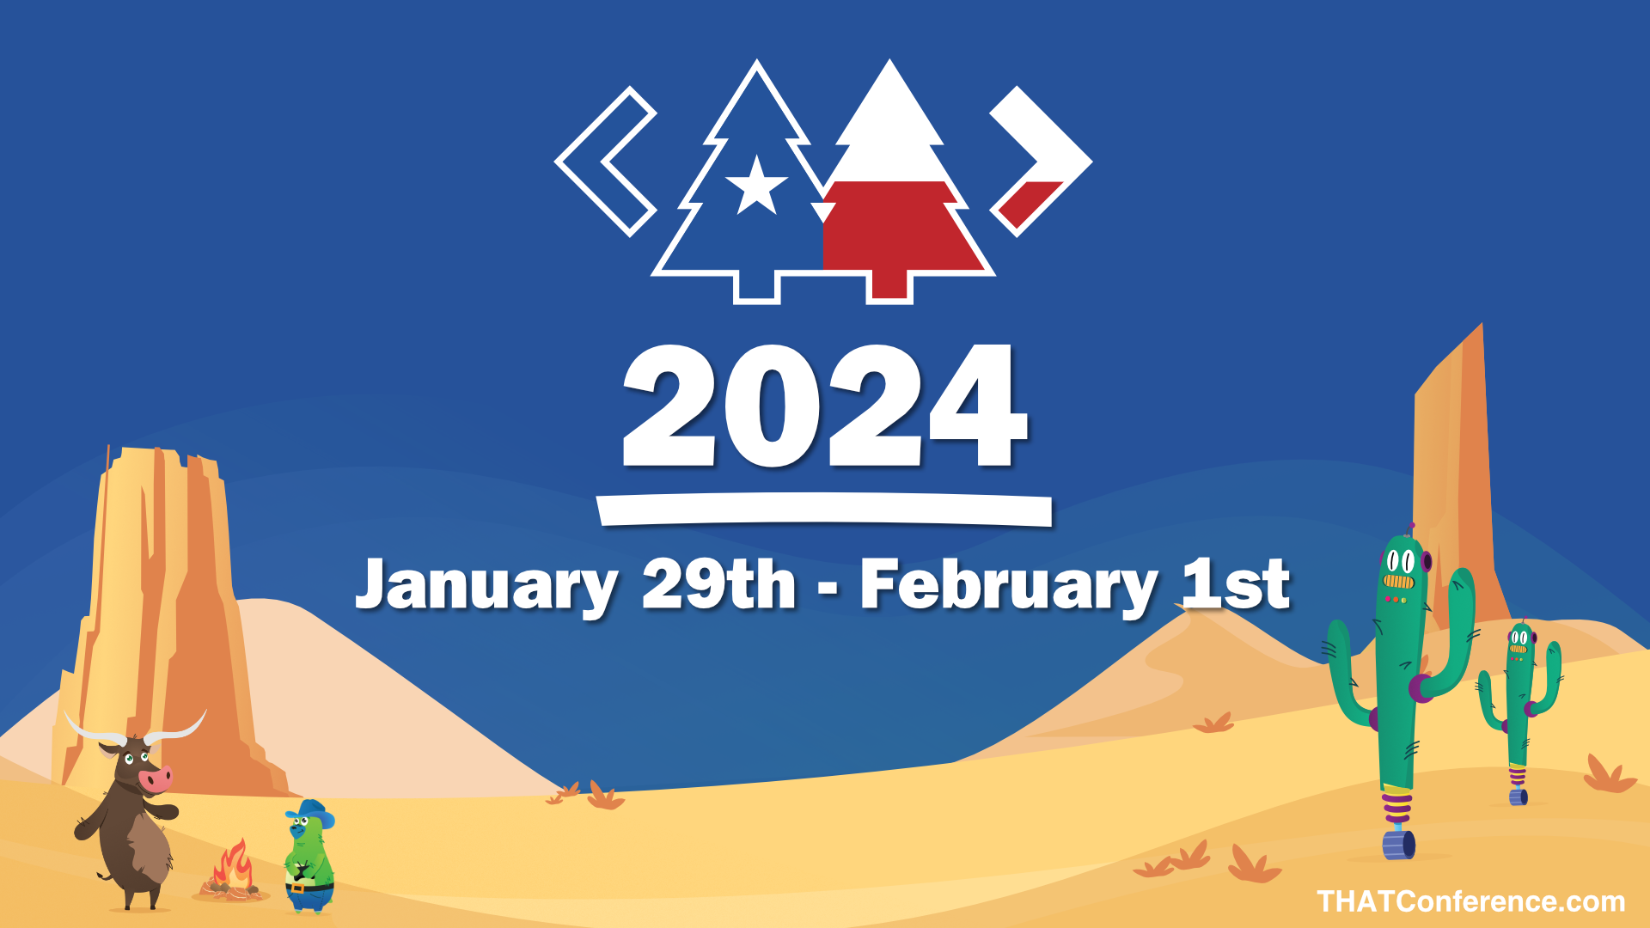
Thank you!

Slide 61

Discussion?
Naming Things Repo, Slides, References, etc.:
peter@peterRitchie.com

